Slide 1


Secure Testing
Anytime. Anywhere. Any Method.
Ryan Burg
Director of Business Development
Academic Markets

Slide 2







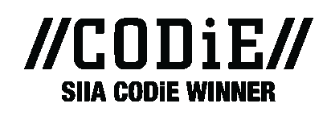
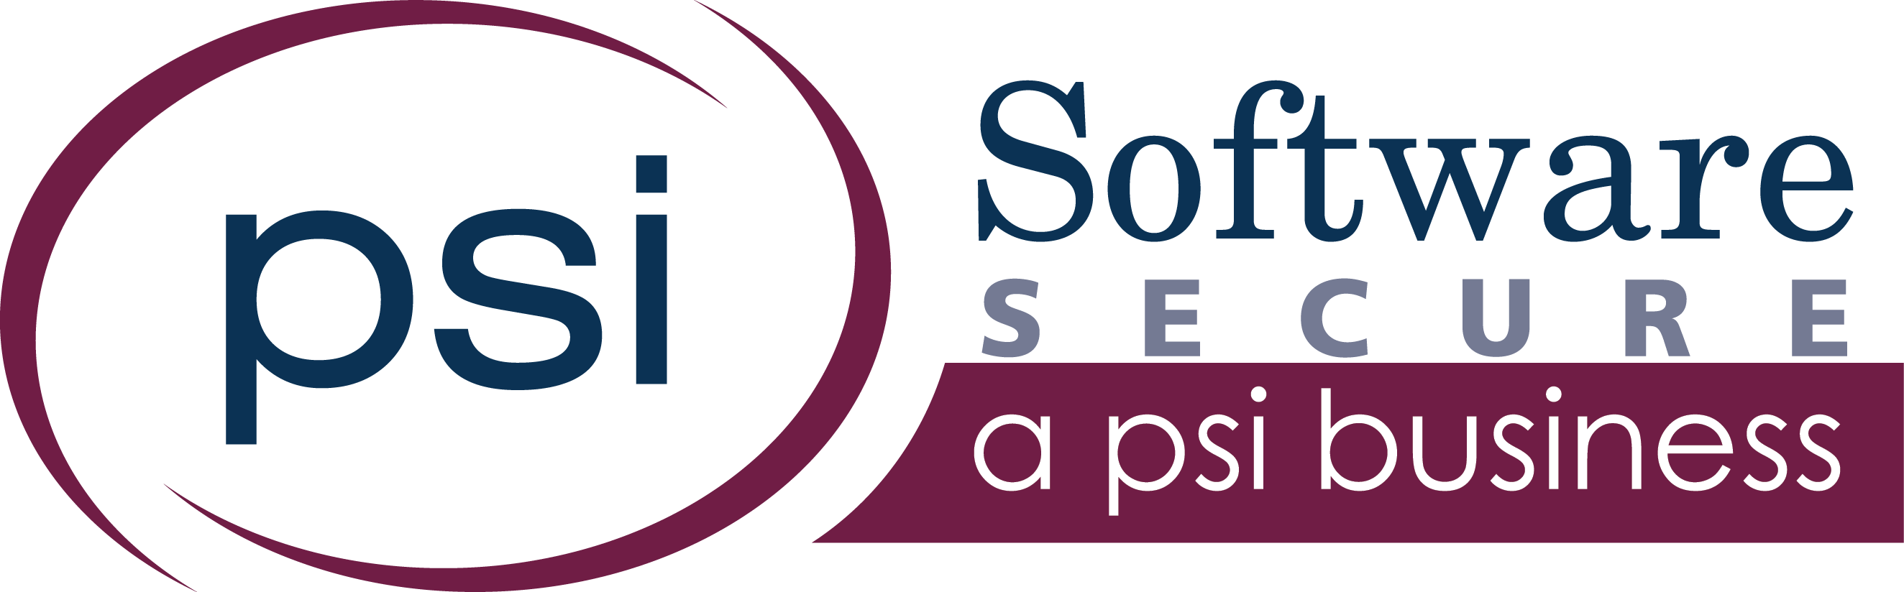


About PSI/Software Secure
Software Secure founded in 1998
2016: Acquired by PSI Services, LLC (founded 1946)
HQ in Newton, MA | WW HQ in Burbank, CA
Industry pioneer and recognized market leader
450+ college, university, K-12 and certification customers
1,500+ total customers
Millions of exams proctored

Slide 3
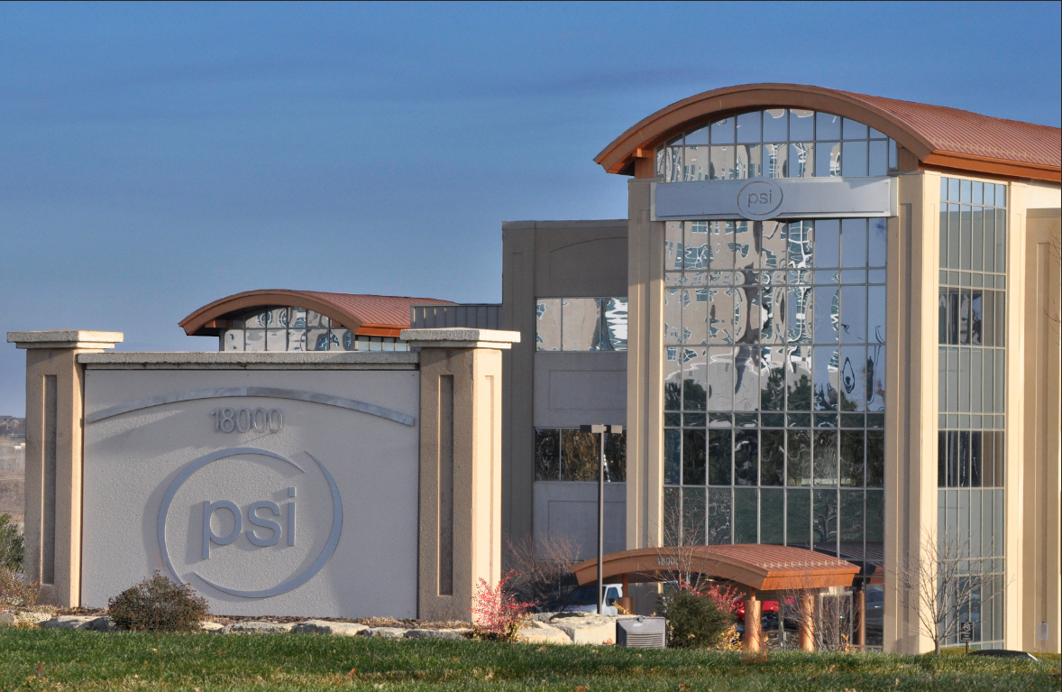
About PSI

Slide 4

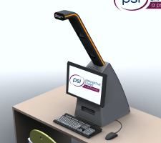


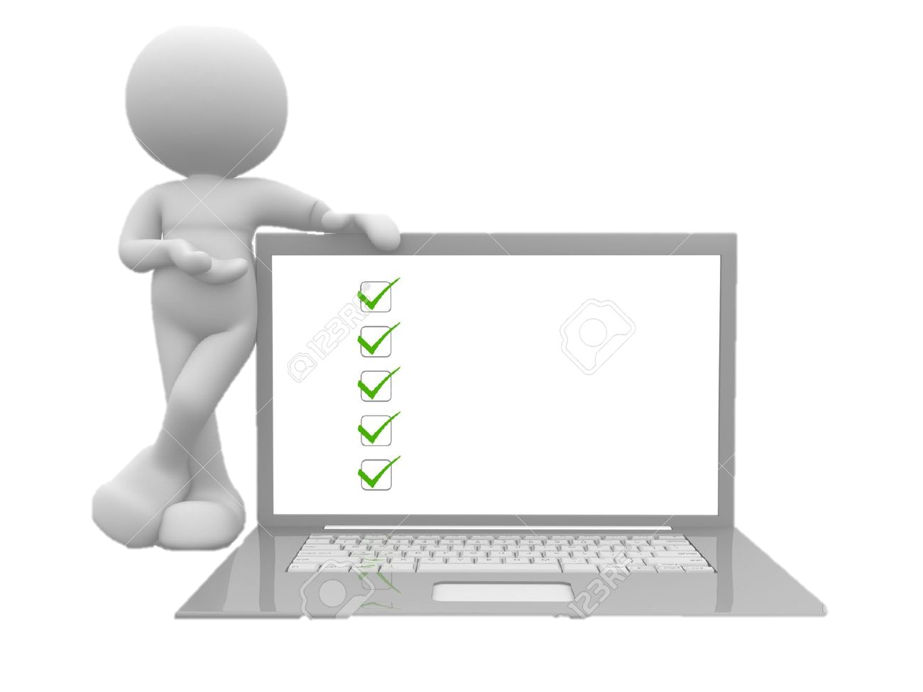

Full Array of Exam Delivery Options
Global Secure Test Centers
Exclusive, Secure Testing Kiosks
LMS
Live, Remote Proctored
RPNow, Record and Review
Unproctored

Slide 5
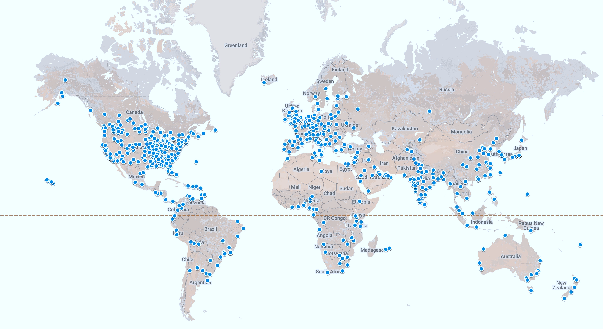
Global test center footprint
for traditional test delivery

Slide 6

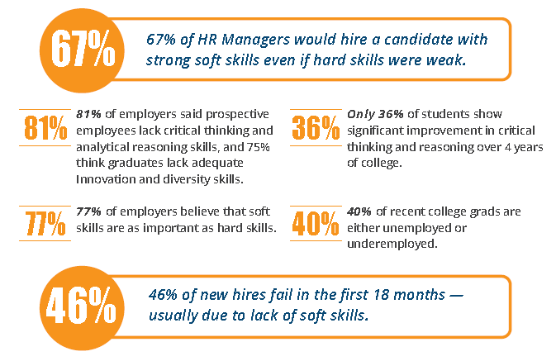
PSI Value
The Am I Job Ready system leverages experience in scientific competency measurement, knowledge of the skills employers desire when hiring successful employees, and industry-leading technology to help employers and institutions close the soft skills gap. Clients use Am I Job Ready because they want measureable outcomes with real-world application.

Slide 7



Online Proctoring Market
A
B
C
Live Proctoring
On-Demand Proctoring
Automated Proctoring
Expensive
Scheduling Required
Proctor watches live
Best of both worlds
No Scheduling
Record & Review
Machine learning
No Scheduling
Faculty review videos
4

Slide 8


The RPNow Platform
On-demand
Authenticates
Records
Each exam
reviewed
Cost effective
student can take exam anytime, anywhere
identity of the exam taker and keeps record of it
webcam view, desktop & audio monitored
by a certified review specialist 1:1
flat exam fee,
all exams the same price, no late fees

Slide 9



RPNow Methodology
With RPNow, human proctors and auditors review each student’s exam session independently to ensure compliance with exam policies.

Slide 10
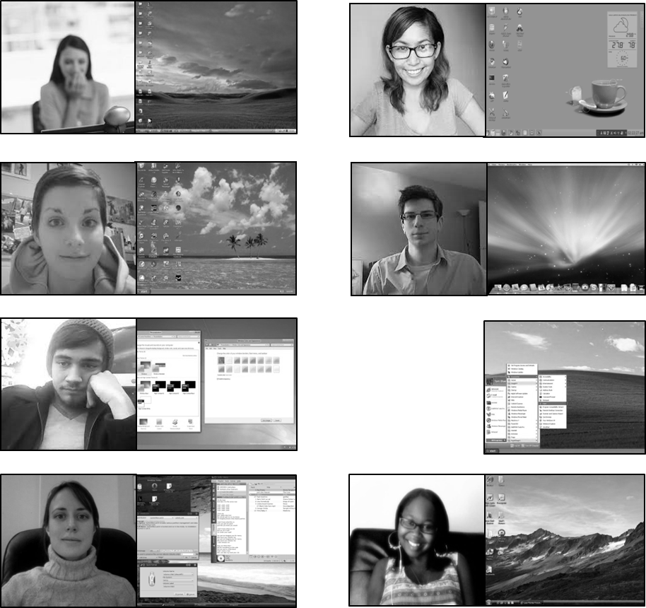

Live Proctoring Methodology

Slide 11

Automated Proctoring
Automated Proctoring tries to use technology alone, eliminating the human,
to determine if a student is cheating (if it walks like a duck…)
Machine Learning Primer
Automatic learning and
feature selection
· Supply training data
(+ve and –ve classes)
Ducks
Not Ducks
Big Data Clustering
0,8631 Bad
0,9784 Bad
Clustering
Good (Duck)
Bad (Not a Duck)
Unknown
0,8631 Bad
9

Slide 12
Student Benefits
On Demand
Take exams on their own schedule
Consistent access to exam in 5 minutes
24 hours a day, 7 days a week
Easy to use
No advanced setup required
No third party software
Low Cost
Flat fee for every exam
No late fees
Low Minimum
Requirements
125 kbps upload speed
Excellent for slow connections and international students

Slide 13
Teacher/Admin Benefits
Exam Setup
LTI Integration allows fast exam registration
Register multiple exams at once
Exam
Flexibility
Works with all platforms
Open book, closed book, and everywhere in between
Customizable and configurable security
Cannot take exam outside secure environment
Can stop programs and processes from running
Security
Support
7% first time hit rate
24x7 dedicated Staffing

Slide 14




























450+ Customers // Partial List

Slide 15
Demo Time
Faculty
How do I setup an exam?
  - Dates/Times
  - Rules
Reviewing integrity reports
1
Students
How do I take an exam?
  - What do I need?
  - What are the expectations?
2

Slide 16
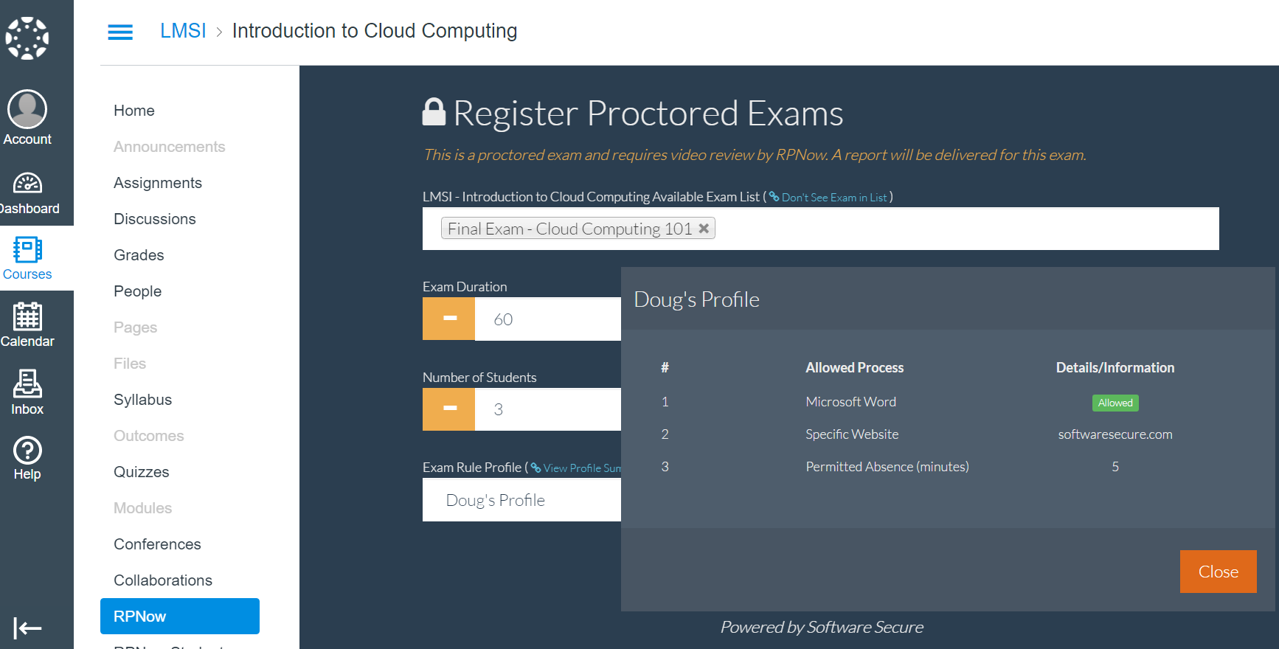
Customizable security

Slide 17
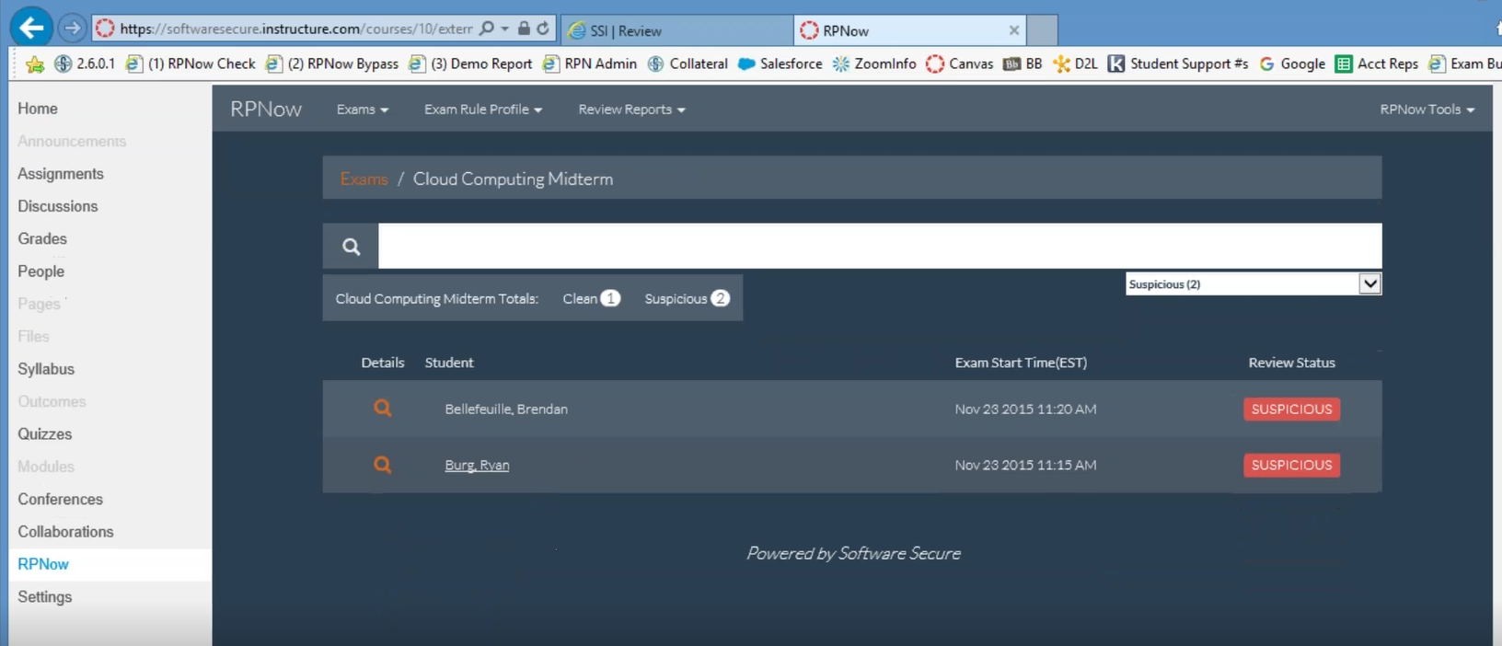
Summary of Suspicious Exams

Slide 18
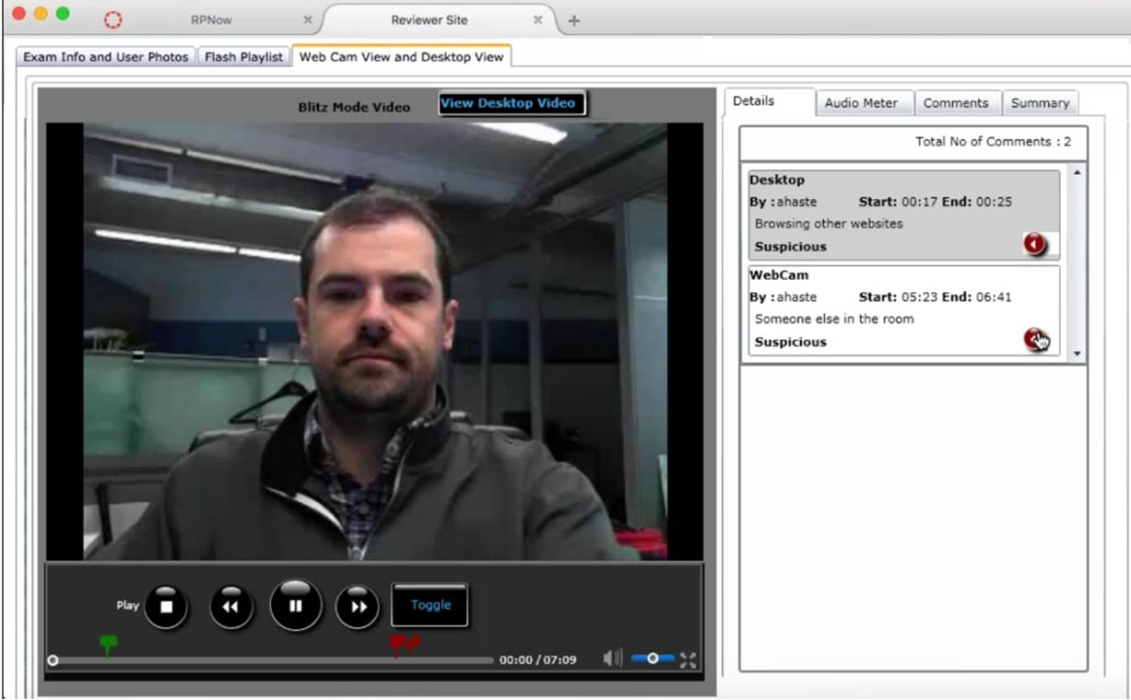
Quick clear path to the evidence

Slide 19
Why Software Secure
“To ensure the integrity of academic credit, in addition to verifying the identity of the student, we now need to verify the integrity of the test itself.
Software Secure’s RPNow system does both and is the ideal solution for the edX platform.”
ANANT AGARWAL
CEO, edX

Slide 20
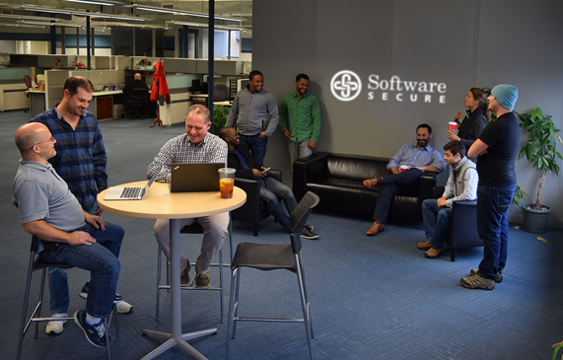
Q&A
RYAN BURG| DIRECTOR OF BUSINESS DEVELOPMENT, ACADEMIC MARKETS
rburg@softwaresecure.com
PSI/SOFTWARE SECURE is the leading provider of secure and cost-effective computer-based testing solutions for any learning environments in higher education, K-12 and certification programs. With award-winning solutions that provide robust authentication and scalable security, institutions can now achieve secure, convenient online exam integrity anytime, anywhere. Software Secure is headquartered in Newton, MA, USA
More about Software Secure can be found at WWW.SOFTWARESECURE.COM

