Slide 2
ICCOC Spring Conference April 3-4, 2017

Slide 3
Alignment in Course Design from Start to Finish

Slide 4
Learning Objectives
Learning objectives, or course/program competencies, should describe outcomes that are measurable.
Which of these are measurable objectives?
“Students will be able to list the bones in the body.”
“Students will understand the concept of gravity.”
“Students will describe the parts of the internal combustion engine.”
“Students will read classical works of literature.”
“Students will participate in creating a safe environment for open communication.”

Slide 5
Learning Objectives
Module/unit learning objectives or competencies must describe outcomes that are measurable and consistent with the course-level objectives or competencies
Course objective: Students will create a marketing plan proposal reflecting their knowledge of current marketing theory.
What would be appropriate or inappropriate modular objectives?

Slide 6
Learning Objectives
All learning objectives or competencies are stated clearly and written from the learner’s perspective.
What’s wrong with this objective???
Relying on ITIL and best practices utilizing IPSEC and other domain policies, students will create a network plan that monitors and records all UDP and TCP traffic while promoting low-latency and loss tolerating connections.

Slide 7
Learning Objectives
The relationship between learning objectives or competencies and course activities is clearly stated.
How can this be effectively done?
Cite the corresponding standard with each activity and assessment
Insert a table in the syllabus or course that lists activities and related standards

Slide 8
How would that look when designing?

Slide 9
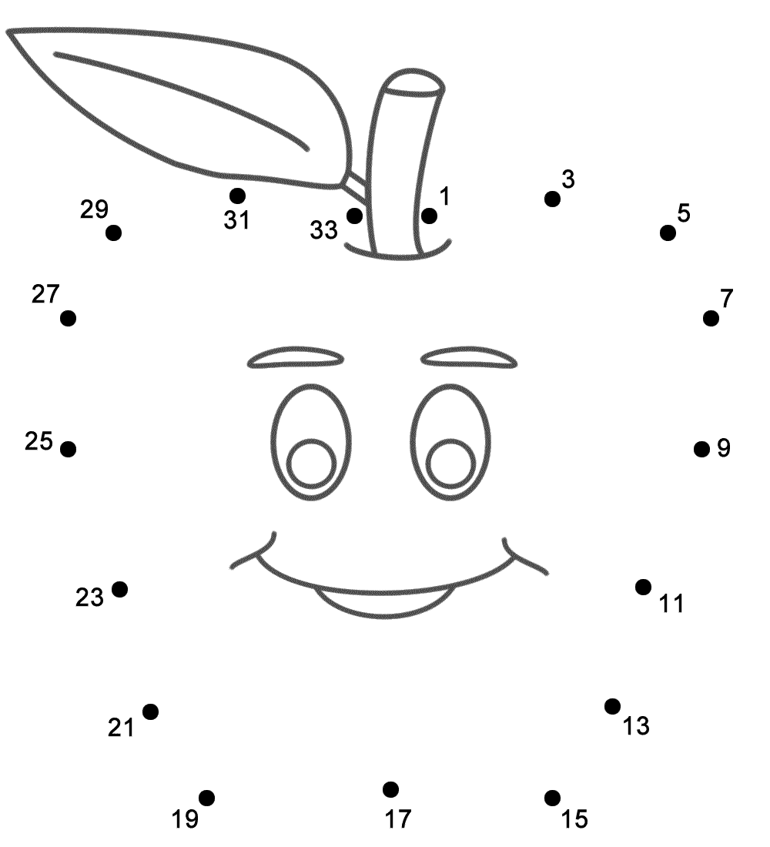
How would that look in the course?
Week | Activity | LO | CO
1 | Review Lesson Video | LO1.1 | CO 1
1 | Group Discussion | LO 1.2 | CO 1
1 | Case Study Exercise | LO 1.3 | CO 2
Students learn better when they understand why they are doing what they are doing! Help them connect the dots!

Slide 10
Learning Objectives
The learning objectives or competencies must be suited to the level of the course
Note:
This is subjective, and may require a holistic view of objectives across the program to ensure students are prepared for scaffolded competencies

Slide 11
Applying Bloom’s Taxonomy

Slide 12
Resources for Creating Learning Objectives
ASU Online Objective Builder
http://teachonline.asu.edu/objectives-builder/
Bloom’s Taxonomy Action Verbs
http://www.fresnostate.edu/academics/oie/documents/assesments/Blooms%20Level.pdf

Slide 13
“Key” Takeaways
First
Course Objective
Second
Lesson Objective
Third
How it will be assessed
Fourth
Activity/ Content
Course objectives are the road map. Without good objectives, students don’t know where they are going and why!
Notes:
Are these in the right order? Or are the third and fourth parts reversed?

Slide 14
Assessments

Slide 15
Assessment & Measurement
Assessments are integral to the learning process and are designed to evaluate learner progress in achieving the stated learning objectives or mastering the competencies.
Assessments should measure the stated learning objectives or competencies.

Slide 16
Assessment & Measurement
The assessment instruments selected should be sequenced, varied, and suited to the learner work being assessed.
Role Play
Debate
Case Studies
Blogs
Essays
Project Based Learning
Research
Drill and Practice
Notes:
3.4
Variety of assessments
Need a chance to excel and master
3.5
Feedback, substantive, timely
Constructive
Assessment or Instructor

Slide 17
Assessment & Measurement
An effective course provides learners with multiple
opportunities to track their learning progress.

Slide 18
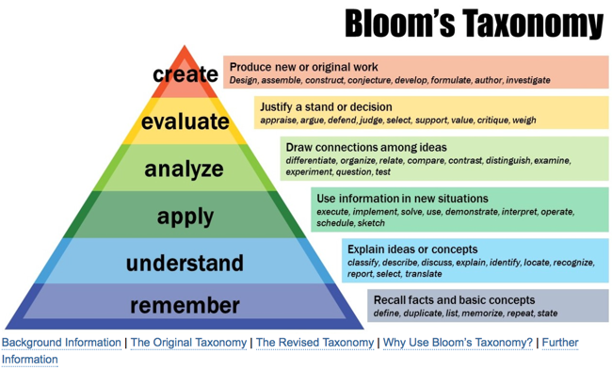
Assessment & Measurement

Slide 19
Assessment & Measurement
Formative Assessments check learner’s progress
Notes:
Reflection Journal: Formative & Summative; can also apply to blogs: https://drive.google.com/file/d/0B6KGjUdkIcd5c2VhZUNfZXpxbkE/view?usp=sharing
Formative: 5 Minutes to Go: https://drive.google.com/file/d/0B6KGjUdkIcd5d0gtSFlDU1V3cDQ/view?usp=sharing
Discussions, Knowledge Checks (graded & ungraded), practice quizzes
Note – quizzes should allow for multiple attempts so learners can gain content knowledge and demonstrate improvement
Varied
Allows for learner improvement
Authentic
Inclusive & diverse
Addresses all areas of learning content
Changes in learner’s progress documented
Intensity & frequency designed to meet learner’s needs

Slide 20
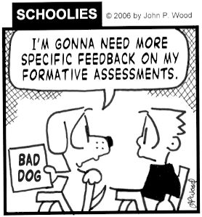
Assessment & Measurement
Formative Rubrics
Allow for improvement & constructive feedback
Notes:
Reflection Journal: Formative & Summative; can also apply to blogs: https://drive.google.com/file/d/0B6KGjUdkIcd5c2VhZUNfZXpxbkE/view?usp=sharing
Formative: 5 Minutes to Go: https://drive.google.com/file/d/0B6KGjUdkIcd5d0gtSFlDU1V3cDQ/view?usp=sharing
Discussions, Knowledge Checks (graded & ungraded), practice quizzes
Note – quizzes should allow for multiple attempts so learners can gain content knowledge and demonstrate improvement

Slide 21
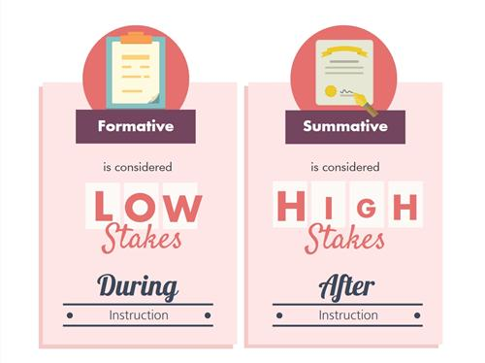
Assessment & Measurement
Summative Assessments:
Assesses overall content mastery
Allows for demonstration of course objectives/outcomes met
Demonstrates mastery of content
Highest levels of Bloom’s (Create or Evaluate)
Notes:
Reflection Journal: Formative & Summative; can also apply to blogs: https://drive.google.com/file/d/0B6KGjUdkIcd5c2VhZUNfZXpxbkE/view?usp=sharing
Scaffolded, room to demonstrate, choices, personalization,
Examples:
ePortfolios
PLE/PLNs
Exams (minimal)
Research papers
Presentations & curation projects

Slide 22
Assessment & Measurement
Summative Rubrics
Clear criteria
Weighted properly
Provided before assessment
Notes:
Reflection Journal: Formative & Summative; can also apply to blogs: https://drive.google.com/file/d/0B6KGjUdkIcd5c2VhZUNfZXpxbkE/view?usp=sharing
Remember to balance criteria points…
You don’t want the grammar/spelling to be the same weight/amount as the content! ☺

Slide 23
“Key” Takeaways: Assessments
Must show mastery of content
Specific & descriptive criteria for evaluation
Multiple assessments strategies
Frequent, substantive, & timely feedback
Notes:
As a group, we will summarize what each of these points means

Slide 24
Activities
Notes:
The important thing here is to make certain that you are creating interactions that will promote the learner’s achievement of the Module / Unit / Weeks objectives. There are a couple interactions that are an exception to this rule, such as an introductory discussion forum and a general forum to ask questions. It is a great idea to create opportunities for students to talk about related materials that are not part of the normal discussion forums.
Every learning activity in your unit should be intentional, meaningful and useful.
Activities which involve student interaction with content can include listening to and/or watching a live or recorded talk, engaging with a written or visual text, engaging with multimedia, or a combination of these. Typically, students are more likely to retain information presented in these ways if they are asked to interact with the material in some way, which is why it is useful to ask or invite questions, or include another activity type after every 5 or 15 minute 'chunk' of information.

Slide 25
Course Activities and Learner Interaction
Course activities should facilitate and support learner interaction and engagement.
The learning activities should promote the achievement of the stated learning objectives or competencies.

Slide 26
Course Activities and Learner Interaction
Learning activities provide opportunities for interaction that support active learning.
Activity or Content | Promotes
Reflection/Research | Independent & active learning
Database Searching | Independent & active learning
Collaboration Documents | Group/Independent & active learning
Simulations | Reflects real-life scenarios (Active)
Multimedia | Self-checks, immediate feedback (Active)
External Resource Curation | Group/Independent & Active learning
Notes:
The Community of Inquiry Model is a prime example of interactive, active learning, which is what this standard is all about. All three types of interactions should be present in an online course.
Reflection/Research: Possible interactions: Blog about findings, share through Pinterest board, reflect using video: Create
Database Searching: Interactions: Blogging, Wiki, curation (Scoop.it), folder in Canvas
Reviewing documents: Interactions: Google Docs (example to follow), shared through Evernote, shared peer reviews
Simulations: Interactions: virtual museums, online simulations, created simulations (http://www.worldwarfighter.com/hajikamal/activity/_
Multimedia: self created videos, OERs, podcasting, Zaption (see example)
External Resources: Study.com, Khan Academy, OERs
Remember, it doesn’t mean we have to reinvent the wheel! There are hundreds of thousands freely accessible activities and created content in the world of OER!
http://elearningexamples.com/interactive-infographic-timeline-for-e-learning/
www.oercommons.org

Slide 27
Three types of interaction
Student
Peer
Instructor
Content

Slide 28
Course Activities and Learner Interaction
The requirements for learner interaction are clearly stated.
Notes:
In world of online learning, students have access to their courses 24 hours a day, 7 days a week. This type of access to the course also makes students think they have 24 hours a day, 7 days a week access to the instructor. This is, of course, a misconception.
A clear explanation of the requirements for learner interaction helps learners plan and manage their class participation and is important for promoting learners’ active involvement in the course. The statement of requirements also provides a basis for the instructor to evaluate learner participation. The more specifically the expectations are explained, the easier it is for the learner to meet the expectations. Clearly explaining the role of the instructor and expectations for interactions with the instructor and with other learners is especially helpful to learners from cultures in which deference to the instructor is customary and who may need encouragement to speak up.
http://facultyecommons.com/quality-matters-monday-standard-5-4/

Slide 29
“Key” Takeaways: Interactive & Engaged
Promote mastery of objectives
Encourage engagement
Learner-Instructor
Learner-Content
Learner- Learner
Clear expectations & feedback
Notes:
As a group, we will summarize what each of these points means

Slide 30
Conclusion

