Slide 1
A Model for LMS-Based Online Learning Orientation
Martin LaGrow
Senior Academic Consultant
April 4, 2017
Dr. Dean M. Julian
Director for Online Undergraduate Instruction
Immaculata University
Notes:
Note that this can be developed in any LMS—the principles of the course are LMS agnostic.

Slide 2
Cohort Overview: Online RN-BSN Students Persistence/Retention Rates
 | Fall 2013 Start | Spring 2014 Start
Cohort Enrollment | 29 | 26
Cancelled Pre-Start* | 1 | 6
Cohort Actual Enrollment | 28 | 20
Attrition (Students not enrolled in Summer 2014 courses) | 8 | 4
Overall Retention/Persistence Rate | 71.43% | 80.00%
Students Who Completed Online Orientation
# Students who completed orientation | 19 | 9
Attrition Students who completed orientation | 2 | 0
Persistence/Retention Students who completed orientation | 89.47% | 100.00%
Students Who Did Not Complete Online Orientation
# Students who did not complete orientation | 9 | 11
Attrition Students who did not complete orientation | 6 | 4
Persistence/Retention Students who did not complete orientation | 33.33% | 63.64%
Summary Fall 2013 & Spring 2014
Total Enrolled | 48
Total Attrition | 12
Overall Persistence/Retention Rate | 75.00%
Overall Persistence/Retention Rate Students who completed online orientation | 92.86%
Overall Persistence/Retention Rate Students who did not complete online orientation | 50.00%

Slide 3
Outline of the LMS-Based Online Learning Orientation
Course Introduction
Orient students to LMS and Required Software
Prepare Students for the Nuances of Online Learning
Familiarize Students with Institutional Online Support Services
Inform Students of Institutional Policies and Procedures
Gather Feedback
Notes:
These are the main components of the online orientation.

Slide 4
Course Introduction

Slide 5
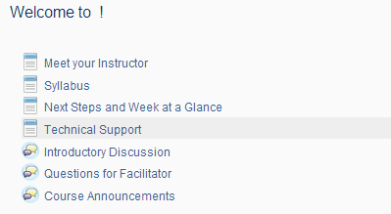
Course Introduction
Content Reflects Institutional LMS Template Information. Typically includes:
Welcome Video by Institutional Leader/Department Chair
Meet the Facilitator
Overview
Introductory Discussion
Technical Support Information
Course Announcements Forum
Questions for Facilitator Forum
Syllabus
Notes:
Most colleges have a course template that includes this basic information. To familiarize students with the layout of courses, the orientation should follow the same model. It is also beneficial to start with a welcome video from a department chair, program director, etc.—someone the students will be able to relate to/look up to.

Slide 6
Orient Students to Required Software
Module 1

Slide 7
Module 1: Orient Students to Required Software
Web browsers
preferred/recommended
Pop/up blockers
Necessary plug-ins
Media Software
Windows Media Player
iTunes
VLC
Office Software
Cloud Software (e.g. Google docs)
LMS Navigation
Practice Assignment Submission
Notes:
In module 1, students should be introduced to the preferred/recommended browser versions for the LMS, basic instructions about pop-up blockers and other required software plugins such as Java and Adobe Flash Player. Students should be advised as to what additional media software they may be required to use. Institutional policy about acceptable software and attainment of office software, if applicable, should be provided. Students should be introduced to cloud software that the institution may use. Finally, the basics of LMS navigation are introduced.

Slide 8
Module 1: Orient Students to Required Software
Week 1 Practice Assignment Submission:
Create a new document. In it, answer the following questions.
1. What web browser do you most often use? What version of your web browser do you currently have?
2. Do you have Adobe Reader or another pdf reader program installed?
3. What Office software do you presently have installed on your computer? If none, are you using online Office software such as Google Docs?
4. What other questions or concerns do you have about your technical readiness?
Submit the document in the module one dropbox.
Notes:
The week culminates with a practice assignment submission in which they answer questions about their own readiness (Office software, browser, etc.) and add any other questions they may have. This activity helps vet student preparedness and introduces them to the dropbox procedure.

Slide 9
Prepare Students for the Nuances of Online Learning
Module 02

Slide 10
Module 2: Preparing Students for the Nuances of Online Learning
Online Learning Tips Presentation (Link to Prezi)
Prepare Yourself;
Gather Support and Identify Resources;
Establish a Study Zone;
Establish a Study Schedule;
Have a Presence;
Anticipate;
Add Value;
Check Your Work;
Learn;
Finish Strong
Notes:
Students are introduced to best practices in online learning and how they can apply them.

Slide 11
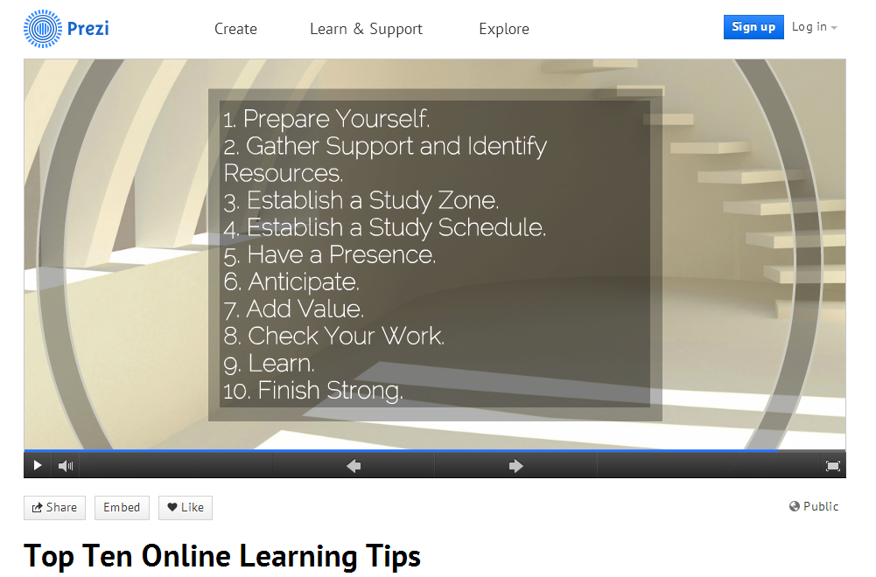
Module 2: Preparing Students for the Nuances of Online Learning
Notes:
This Prezi presentation was developed to explain the top ten online learning tips and can be embedded in an LMS.

Slide 12
Module 2: Preparing Students for the Nuances of Online Learning
Continued…
Applying the Top Ten Tips (Discussion Forum)
Assumptions of Andragogy Video
Self-check Quiz on the Six Assumptions of Andragogy
No-fail quiz
Immediate response feedback
Multiple attempts allowed
Notes:
Other activities of module two include a discussion forum in which students explain how they will apply the top ten tips in their own learning, watch a video about adult learning, and take a quiz about the video. The purpose of the quiz is not pass/fail, rather to give students an opportunity to see how the quiz tool of the LMS works.

Slide 13
Familiarize Students with Institutional Online Support Services
Module 03

Slide 14
Module 03: Familiarize Students with Institutional Online Support Services
Student Services Guide Presentation
Self-check quiz
Questions address where students can find certain resources such as APA style guide, IT live chat, etc.
No-fail quiz
Immediate response feedback
Multiple attempts allowed
Links to Support Services
Library Databases and Journals
Online Tutoring/Writing Lab
IT Support
Notes:
The purpose of module three is to acquaint students with support services available to distance students and how they are accessed. These services typically include library assistance, online tutoring, writing labs, and IT support.

Slide 15
Inform Students of Institutional Policies and Procedures
Module 04

Slide 16
Module 4: Institutional Policies and Procedures
Policies and Procedures Specific to Online
Where to find syllabus information
What students can expect from instructors
What instructors can expect from students
Participation requirements
Institutional Policies and Procedures
Withdrawal Policy
Plagiarism
Accommodations
Departmental contact information
Notes:
Module four provides students with important policies and procedures both specific to online and institutional. Optionally, you may have students post to a forum that they have reviewed and agree to abide by all policies. This course always remains available once completed so students can refer back to the resources of this course if needed.

Slide 17
Gather Feedback
Module 5

Slide 18
Module 5: Gather Feedback
Students participate in a reflective discussion forum with two purposes:
To discuss concerns and aspirations about their online journey
To share constructive feedback on the course and its contents
Students complete a course survey to rate:
The usefulness of topics covered and activities completed
The amount of work required
Their comfort level/preparedness to proceed
Any topics they feel were missed
Notes:
Student feedback provides an opportunity to refine and improve the orientation. If used with cohorts, students have been given the opportunity to bond with their peers.

