Slide 1
Do We Need Badges?
Martin LaGrow
Senior Academic Consultant
April 2017

Slide 2
What is a Badge?
A badge is an electronically awarded symbol of accomplishment.
Example: A student completes Algebra, Geometry, and Trigonometry and is awarded the “Mathemetician Badge.”
Example2: A student participates in five optional live chats in a course and is awarded the “Communicator” Badge.

Slide 3
What are the elements of a badge?
A badge includes the following:
A Name
A description
An image (can be custom or downloaded from many open source badge sites)
The issuer Name (set by LMS)
The issuer Email (set by LMS)
The Badge expiry (optional)
A set of criteria defining how it is issued
A message to the user that is sent once it is earned (optional)

Slide 4
What is a backpack?
At Openbadges.org, anyone can earn, issue, and display badges in their backpack. It links to many educational contexts, including museums, MOOC providers, LMS’s, and schools. An Openbadge backpack is designed to provide validation for the completion of learning objectives in multiple contexts, something like a portfolio.

Slide 5
Application of Badges in Higher Education
Incentivized Programs (Gamification)
 | REWARD | STATUS | ACHIEVE-MENT | SELF-EXPRESSION | COMPETITION
Points
Levels
Challenge
Virtual goods
Leader boards
Growth Engineering (Academy LMS)
http://www.growthengineering.co.uk/the-psychology-of-badges-and-motivation/

Slide 6
Application of Badges in Higher Education
Recognition (Internal)
Professional Development
Purdue Passport
“Learning management mixed with gaming mixed with e-portfolio”
Badges connected with course objectives

Slide 7
Application of Badges in Higher Education
Alternative Credentials (external)
CompTIA—Recognized leader in IT certifications
Why do their certifications have value?
Industry interaction and recognition
Microsoft—Certifies in their own software
Why do their certifications have value?
Knowledge of product
Your Institution—Certifies students with badges
Why do your certifications have value?

Slide 8
Application of Badges in Higher Education
Madison Area Technical College
Noncredit in workforce development
Awarded for program completion
Meeting employer needs
Inform/educate/market to employers
Creating specialized badges
Patterned after certifications

Slide 9
Badges in Action: CS2N
CS2N (http://www.cs2n.org/teachers/badges) uses a badge-based system to motivate students, help them to define pathways and set goals, and indicate that they have mastered concepts.
Badges are a core component of CS2N that seek to solve two key problems:
How do you capture a record of students’ learning in a form that is recognized and valuable everywhere?
How do you encourage students to continue beyond the initial stages of engagement into long-term and lifelong learning?

Slide 10
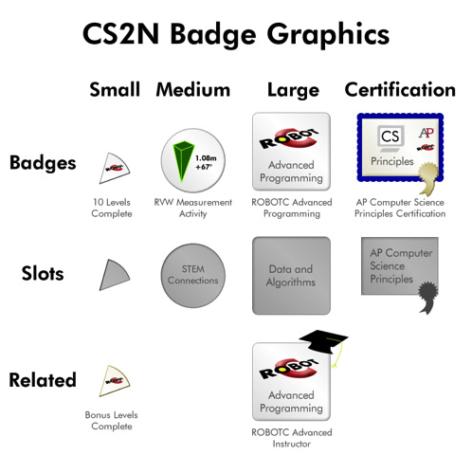
Badges in Action: CS2N
Badges should be MAGIC:
Motivation
Assessment
Guidance
Identification
Certification/Credentialing

Slide 11
Badges? BADGES? Do we need stinking BADGES?

Slide 12
Yes, we need badges!
Badges are considered useful for these main purposes:
To set up an incentivized program within a course, providing motivation to participate (gamification),
To recognize completion of a set of standards,
To provide alternative credentials and recognize independent and informal learning. Badges allow students to “differentiate themselves and tell a narrative (Normoyle, quoted in Inside Higher Education).”
A method of assessment other than “multiple-choice form of testing [that] doesn’t measure all that is being learned and de-motivates true curiosity (Davidson, 2012).”

Slide 13
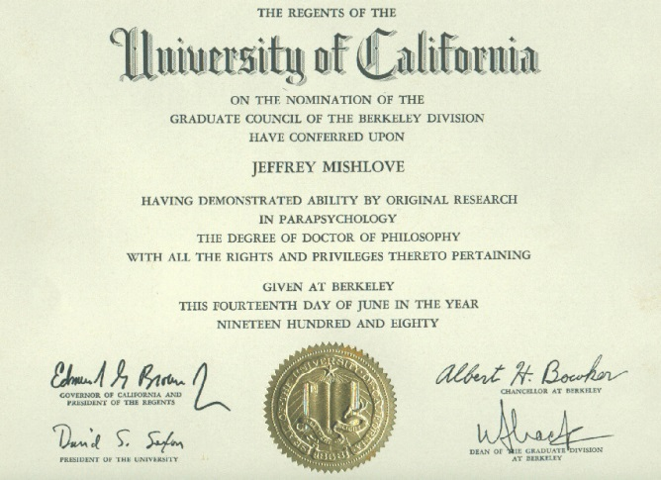
Yes, we need badges!
Digital badges are getting a serious look on many university campuses because they may allow students to demonstrate a greater variety of skills. "A diploma says as much about the institution you attended as it does about you," notes Bill Wisser, instructional designer in the Graduate School of Education (HGSE) at Harvard University (MA). "A portfolio gets more granular, and badges can show individual records of accomplishment (Raths, quoted in Campus Technology)."
What says more about the learner?

Slide 14
We don’t need no stinking badges!
Badges (in gamification) focus on extrinsic instead of intrinsic motivation. “Students will focus on accumulating badges rather than making connections with the ideas and material associated with the badges – the same way that students too often focus on grades…or the points in an educational game rather than the ideas in a game (Resnick, 2012).
Anyone can award badges based on any criteria. What value does a badge from your institution hold in an external context?
“Informal learning works because it is informal. Yet, any coherent system of badges requires systems and structure…too quick a move towards badges runs the risk of destroying the complex but fragile ecosystem within which participatory learning thrives (Jenkins).”

Slide 15
Should your institution launch a badging program?
Are you ready?

Slide 16
Readiness questions:
Will the focus of your badges program be:
Internal—motivation
Internal—recognition
External—validation
How will your badges program be introduced? Will it be a centralized effort or pockets of innovation?
How does the introduction of the badge transform discourse? Will it encourage students to engage more deeply?
How will you maintain the integrity of your ‘brand?’
How will you promote and regulate the issuing of badges?

Slide 17
Relevant Resources
“Badging Alliance” http://wiki.badgealliance.org/index.php/Higher_Education_Working_Group#Examples_of_Badges_in_Higher_Education
“Badging from Within” http://www.insidehighered.com/news/2014/01/03/uc-daviss-groundbreaking-digital-badge-system-new-sustainable-agriculture-program
CS2N http://www.cs2n.org/teachers/badges
Davidson, C. (2012, February 21). “Can Badging be the Zipcar of Testing and Assessment?” http://dmlcentral.net/blog/cathy-davidson/can-badging-be-zipcar-testing-and-assessment

Slide 18
Relevant Resources
Growth Engineering, “The Psychology of Badges and Motivation” http://www.growthengineering.co.uk/the-psychology-of-badges-and-motivation/
“How Badges Really Work in Higher Education” http://campustechnology.com/Articles/2013/06/20/How-Badges-Really-Work-in-Higher-Education.aspx
“How to Earn Your Skeptic Badge” http://henryjenkins.org/2012/03/how_to_earn_your_skeptic_badge.html
Resnick, M. (2012, February 27). “Still a Badge Skeptic.” http://hastac.org/blogs/mres/2012/02/27/still-badge-skeptic
“Rethinking Digital Badges” http://thebluereview.org/rethinking-digital-badges/
“Seven Things You Should Know About Badges” http://net.educause.edu/ir/library/pdf/eli7085.pdf

