Slide 1
Accessibility by Design: Developing a Mindset
Presented by Martin LaGrow, Senior Academic Consultant
ICCOC Spring Conference, April 3, 2017

Slide 2
Information Revolution: Printing Press

Slide 3
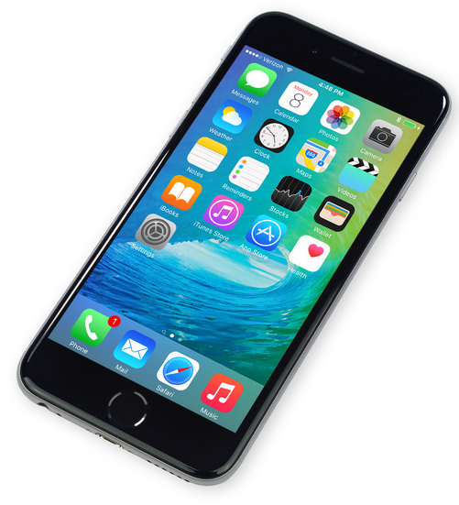
Information Revolution: Technology

Slide 4
Exclusion

Slide 5
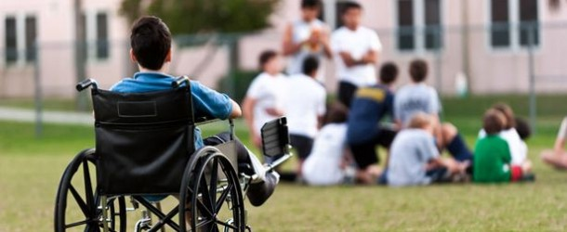
Disability Exclusion

Slide 6
Accessibility

Slide 7
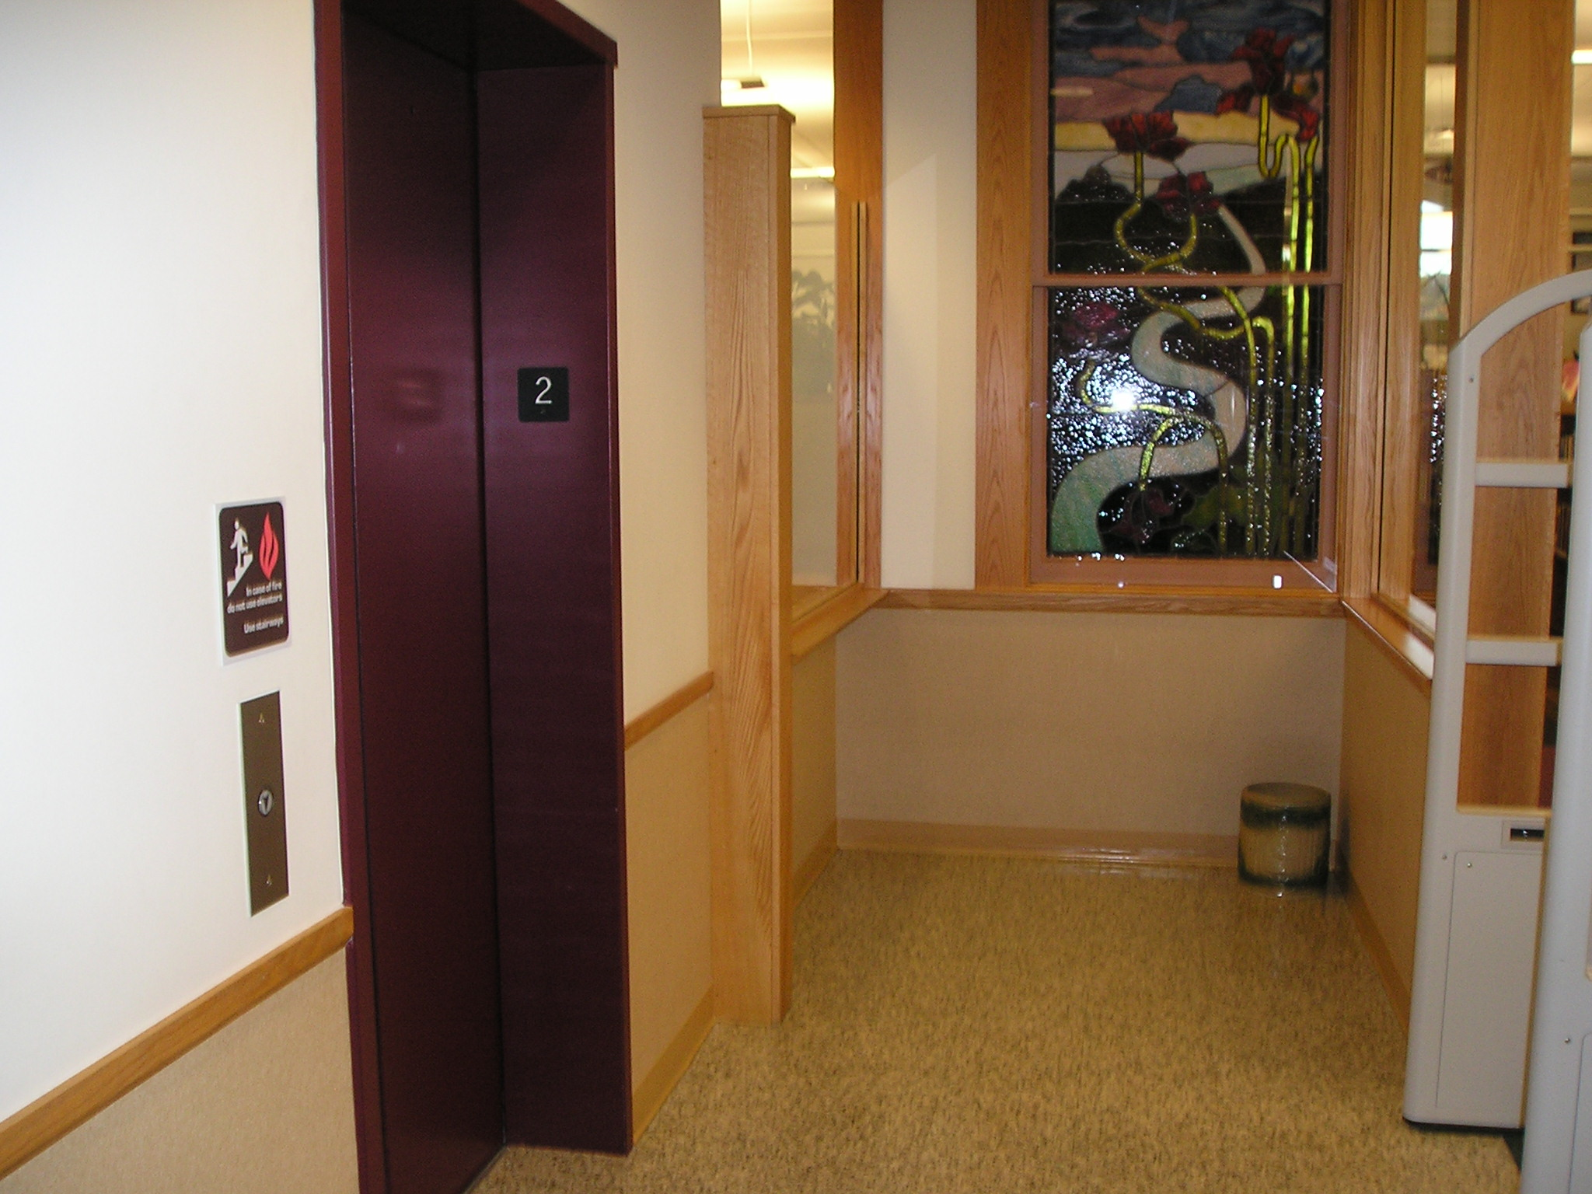
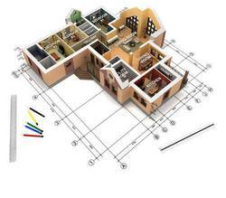
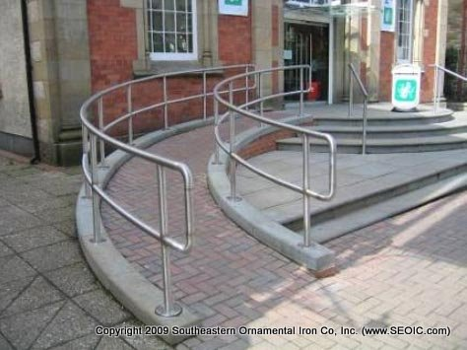
Making a Building Plan

Slide 8
Alleged Disability Exclusion: NAD vs. Harvard & MIT

Slide 9
The Context of Recent History
“Individuals with disabilities must be provided with aids, benefits or services that provide an equal opportunity to achieve the same result or the same level of achievement as others."

Slide 10
Accessibility Requirement
Under Section 508, agencies must give disabled employees and members of the public access to information that is comparable to access available to others.

Slide 11
Accessibility Requirement
The Americans with Disabilities Act applies to distance education.

Slide 12
Accessibility vs. Accommodation
508
Accessibility
504
Accommodation

Slide 13
What’s the Difference?
Accessibility is what we should expect to be ready for us without asking or planning ahead.

Slide 14
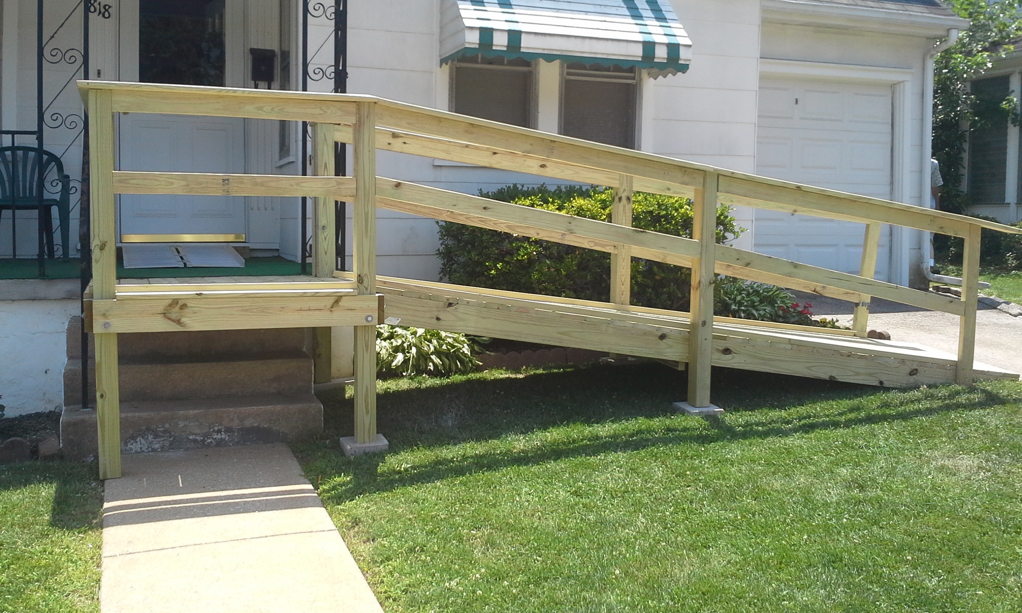
What’s the Difference?
Accommodation is for adaptations that can't be anticipated or standardized.

Slide 15
Other Legal Cases Targeting Accessibility (508, not 504)
Mesa Community College (2012)
Florida State University (2012)
Miami University of Ohio (2014)
Youngstown State University (2014)

Slide 16
Atlantic Cape Community College (2015)
ACCC must:
Hire an outside consultant to evaluate Disability Support Services
Revise disability policies
Provide live training for employees
Develop ADA student training
Complete a technology audit and corrective plan

Slide 17
University of California Berkeley
Free online content is inaccessible to individuals who are deaf or hard of hearing
UC-Berkeley will cut off public access to tens of thousands of video lectures and podcasts in response

Slide 18
University of California Berkeley
The requirements proposed by the department would require the university to implement extremely expensive measures…
Our first obligation is to use our limited resources to support our enrolled students.”

Slide 19
Benefits for Everyone
“If you add accessibility features, they’re going to serve everybody, so why not encourage the people designing online courses to build that in from the beginning?”

Slide 20
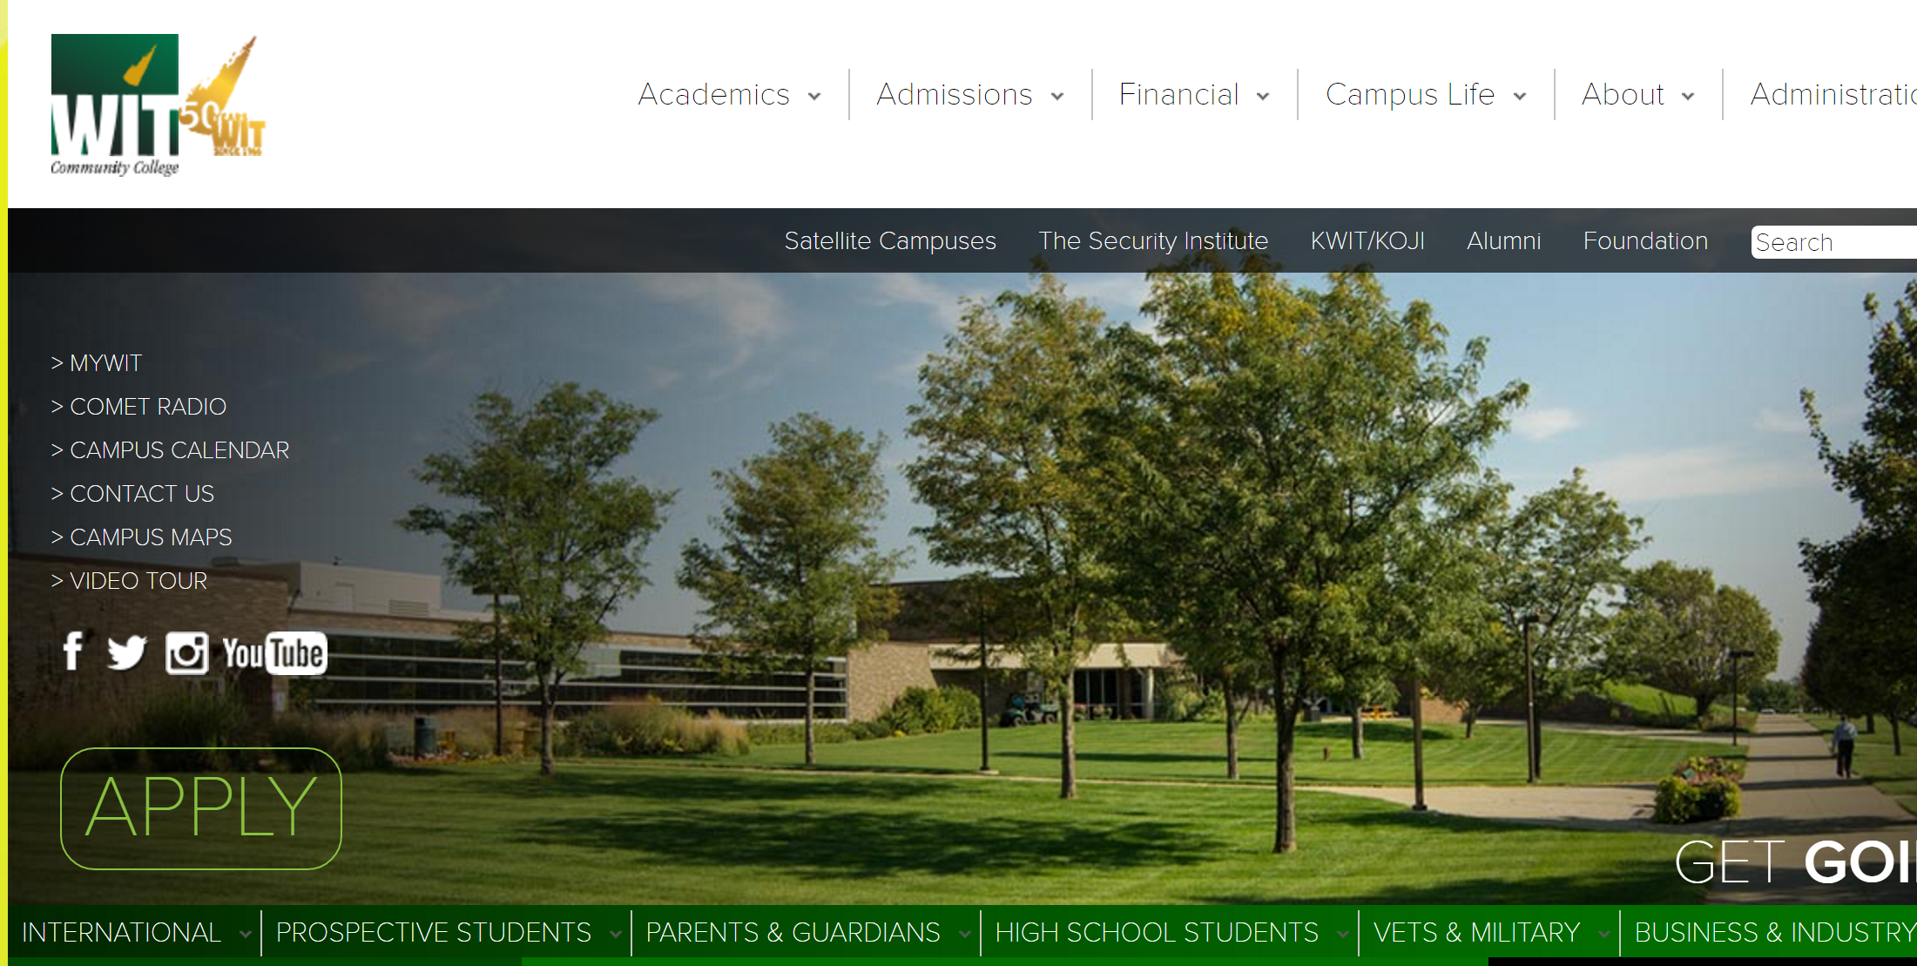
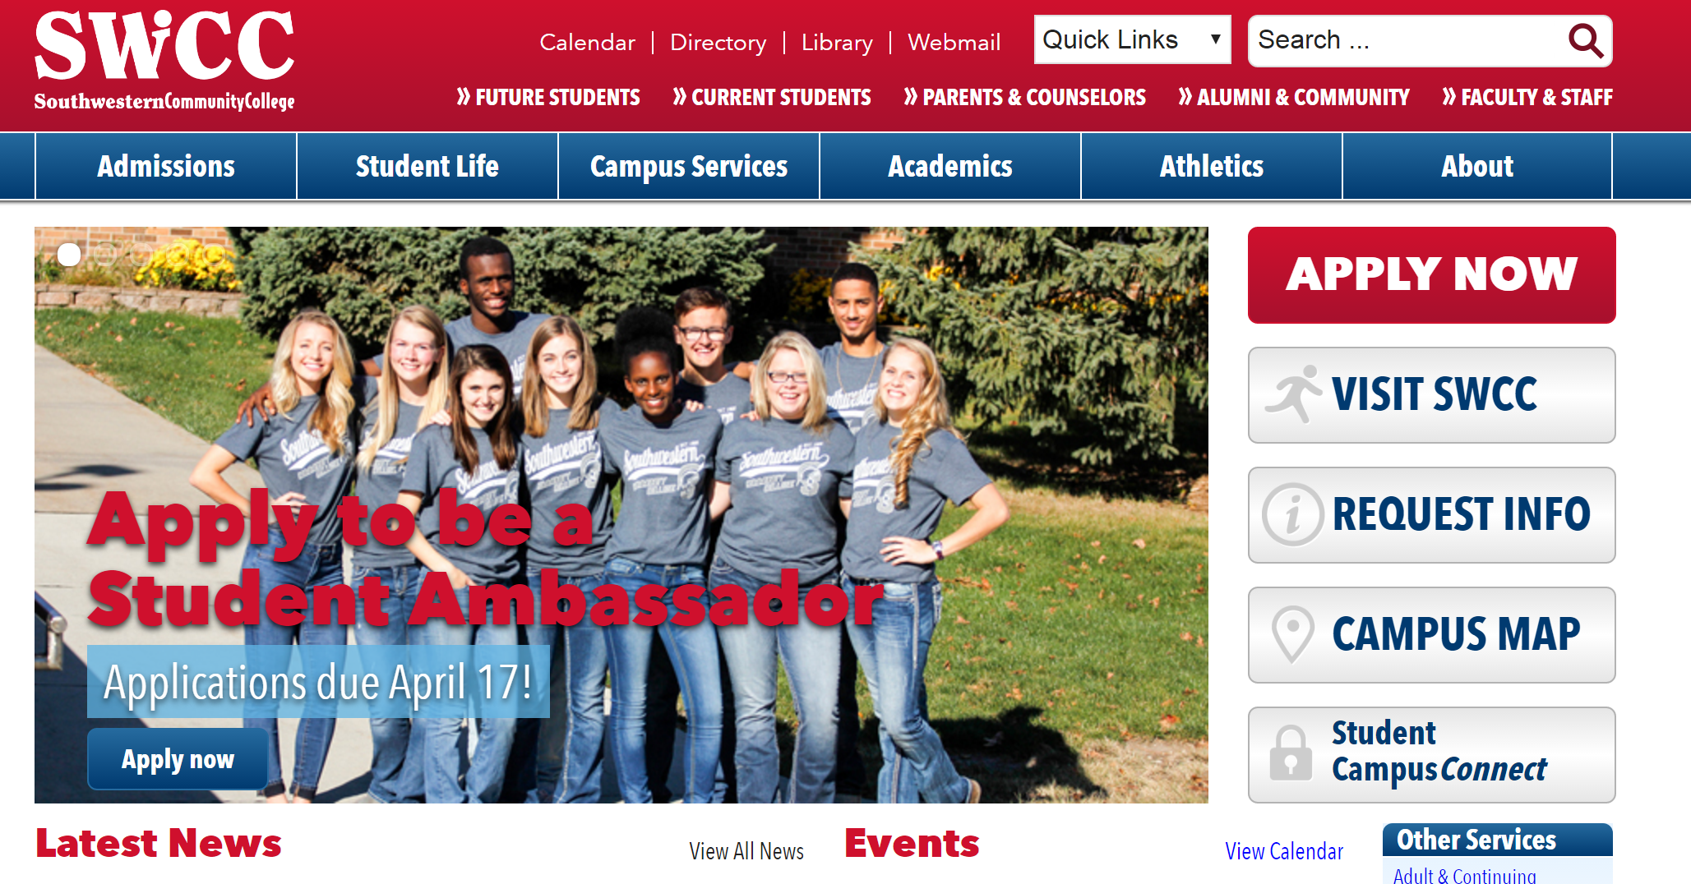
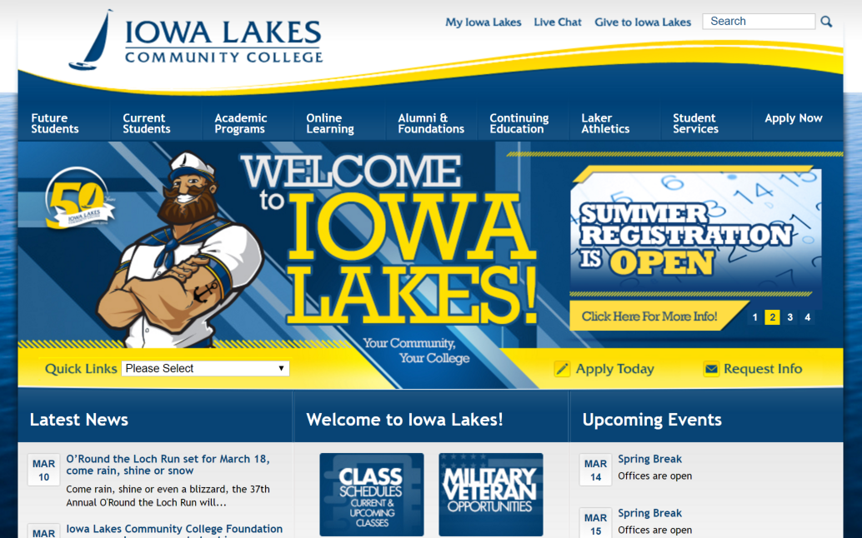
How are YOU Doing? WIT, SWCC, Iowa Lakes, Northwest
Accomodations Information,
Commitment to Accessibility

Slide 21
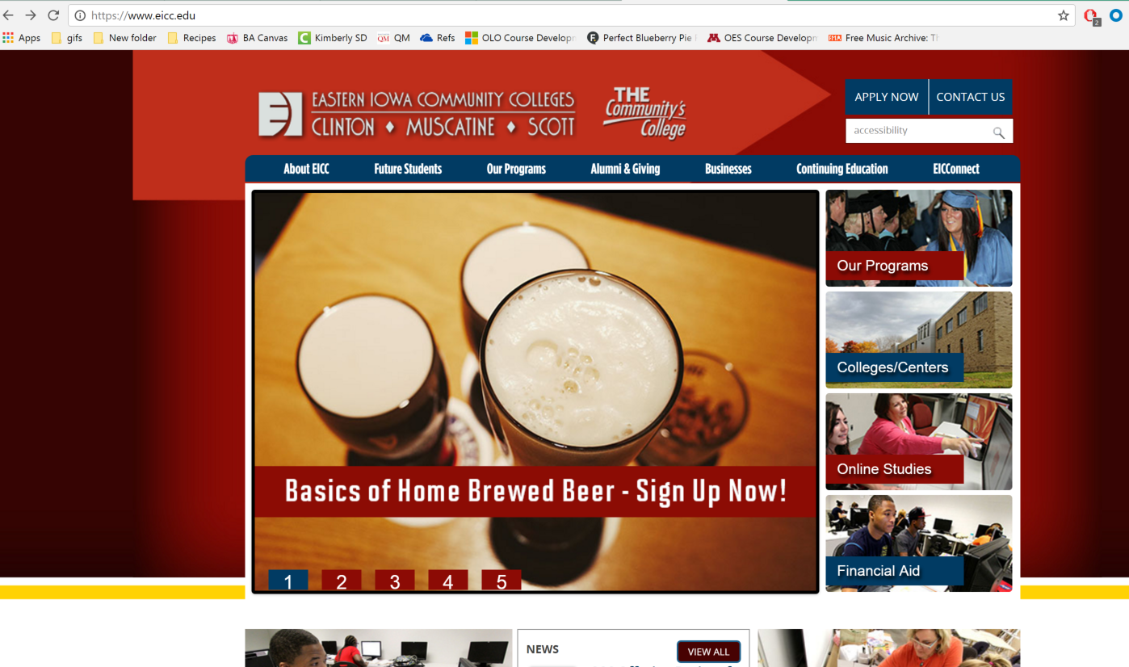
How are YOU Doing? Eastern Iowa Community Colleges

Slide 22
Website Accessibility Statement
Website Accessibility Statement Individuals using assistive technology (such as a screen reader, Braille reader, etc.) who experience difficulty accessing information on this web site, should send an email to eiccinfo@eicc.edu
The e-mail should include the nature of the accessibility problem and the individual’s e-mail address for a response. If the accessibility problem involves a particular webpage, the message should include the URL (web address) of the page. We will contact individuals having accessibility problems within three business days to assist them and to provide them with the information being sought.
Web Accessibility Statement!

Slide 23
How are YOU Doing? Southeastern Community College

Slide 24
How are YOU Doing? Southeastern Community College
Keywords: accessible, alternative textbook delivery, accessibility

Slide 25
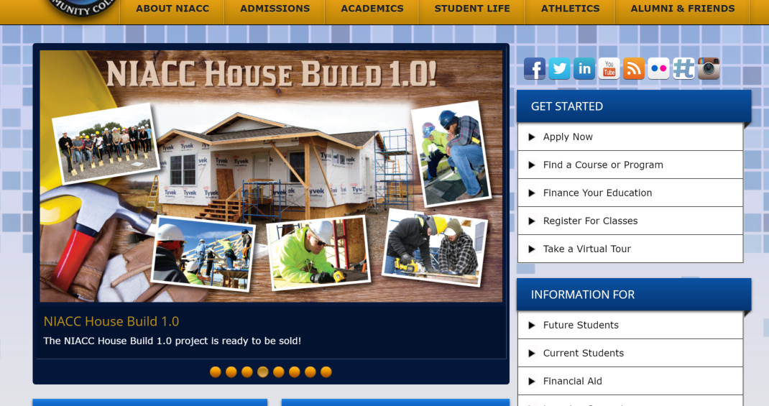
How are YOU Doing? North Iowa Area Community College

Slide 26
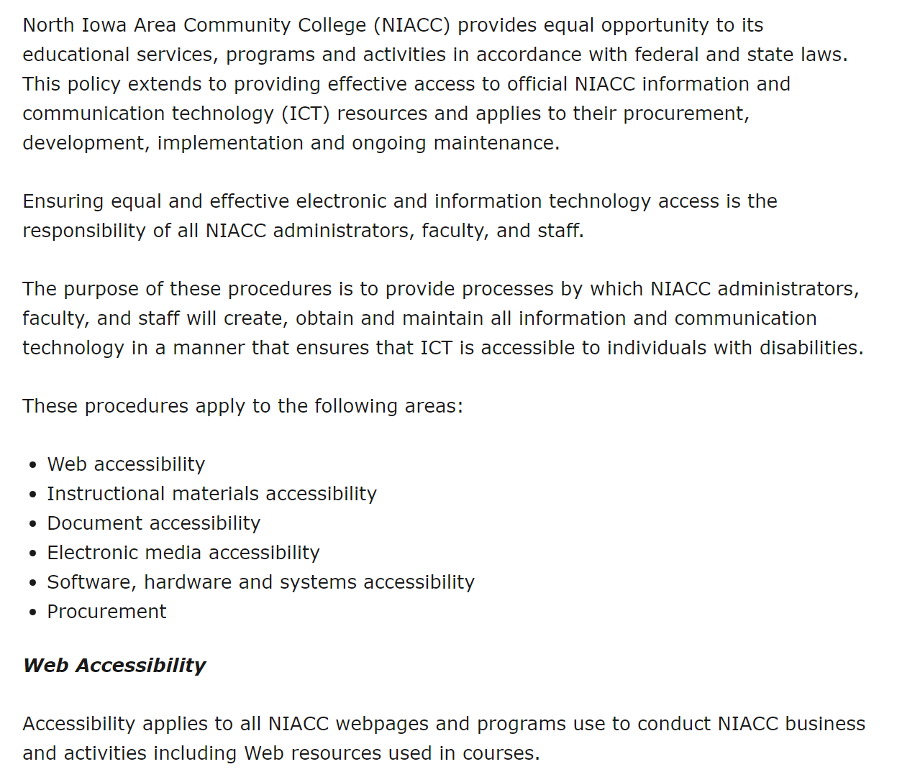
How are YOU Doing? North Iowa Area Community College

Slide 27
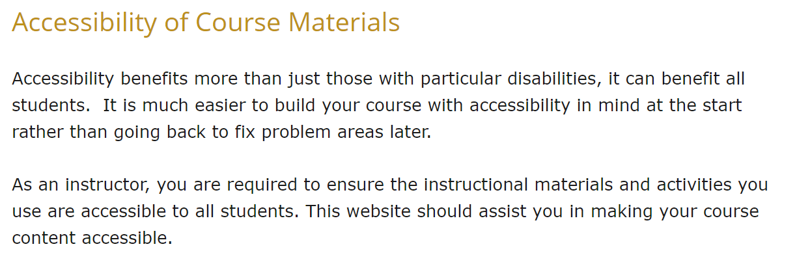
How are YOU Doing? North Iowa Area Community College

Slide 28
Developing a Proactive Institution-Wide Plan
Compliance Committee
Public Statement
Policies & Practices
Accessibility Audit
Training

Slide 29
In Conclusion, Inclusion

